Slide 1

Hyperparameter Optimization w/ Optuna
By: Daniel Sanguino & O’Malley Sherlock

Slide 2
Table of Contents
Importance of Hyperparameter tuning
What is Optuna
Key Concepts: Study, Trial, Sampler, & Pruner
Workflow Overview
Coding Lab!
Some Analysis and Best Practices/Tips

Slide 3
01
Importance
Why should we tune Hyperparameters?

Slide 4
Motivation & Importance
Improve Model Performance
Hyperparameters like learning rate, batch size, etc can drastically affect accuracy, loss and other metrics
Avoiding Manual Trial-and-Error
Manual tuning is time-consuming and often based on guesswork
Some grid and random search methods can be inefficient as they waste time evaluating poorly performing combinations.
Save Time & Compute
Automated tuning reduces the number of training runs needed
Techniques like pruning (used in Optuna) stop bad experiments early, saving resources.
It’s Not One-Size-Fits-All
The best hyperparameters vary across tasks, datasets, and model architectures.
Automated tuning tools adapt dynamically to different optimization landscapes

Slide 5
02
What is Optuna?
What it is and some key concepts and how it works

Slide 6
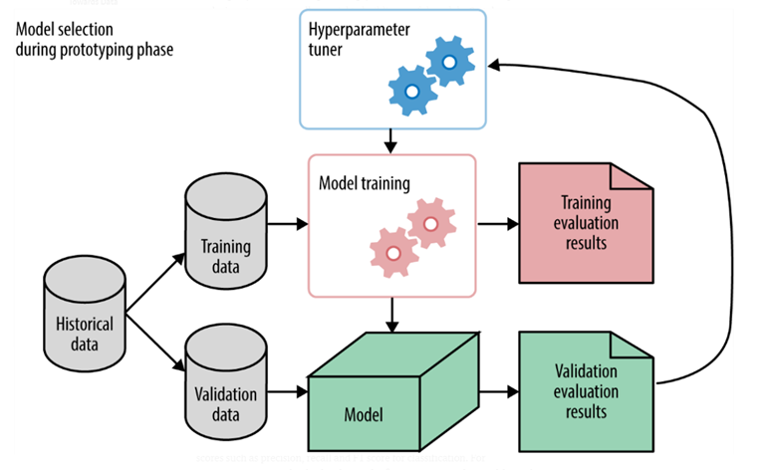
What is Optuna?
Optuna is a fast, flexible, and lightweight hyperparameter optimization framework
Uses a “define-by-run” approach, meaning your search space is built dynamically as the code runs
Supports common libraries such as Scikit-learn, PyTorch, LightGBM, TensorFlow, and more
Uses advanced tuning strategies like Bayesian optimization

Slide 7
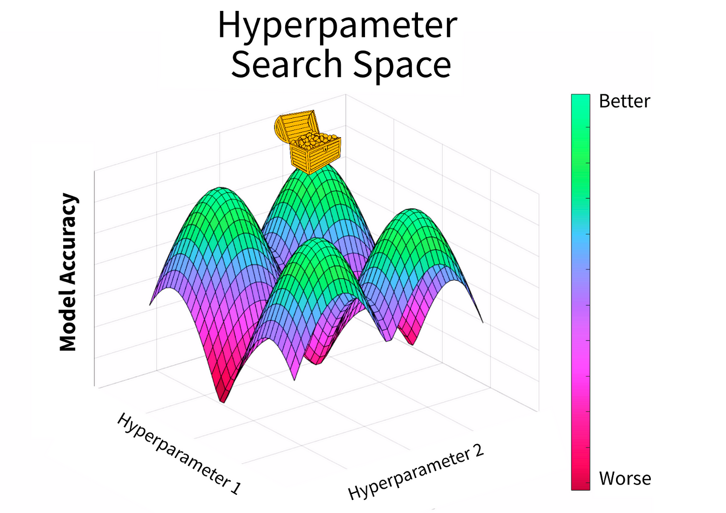
Trials and Studies
Opunta is based on the concept of Study and Trial
A trial is one combination of hyperparameters that will be evaluated
A Study is the process of running through many trials to find the combination of hyperparameters that give the best results.

Slide 8
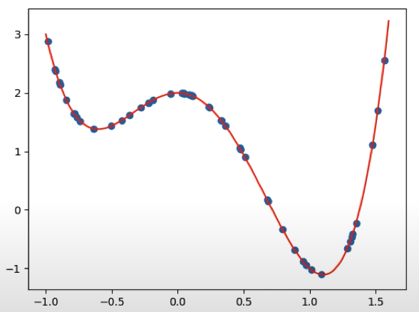
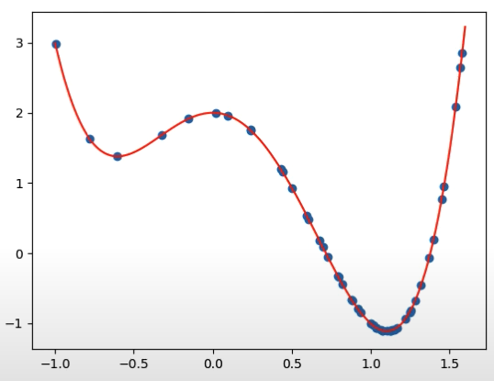
Samplers
Opuntia uses Samplers to focus the hyperparameter search
Tree-Structured Parzen Estimator (TPE)
Gaussian Processes (GP)
Covariance Matrix Adaptation Evolution Strategy (CMA-ES)
Samplers determine the hyperparameters for a trial
Random Search
Optuna
Notes:
Optuna uses bayesian filtering to focus the search closer to where I already has gotten good results

Slide 9
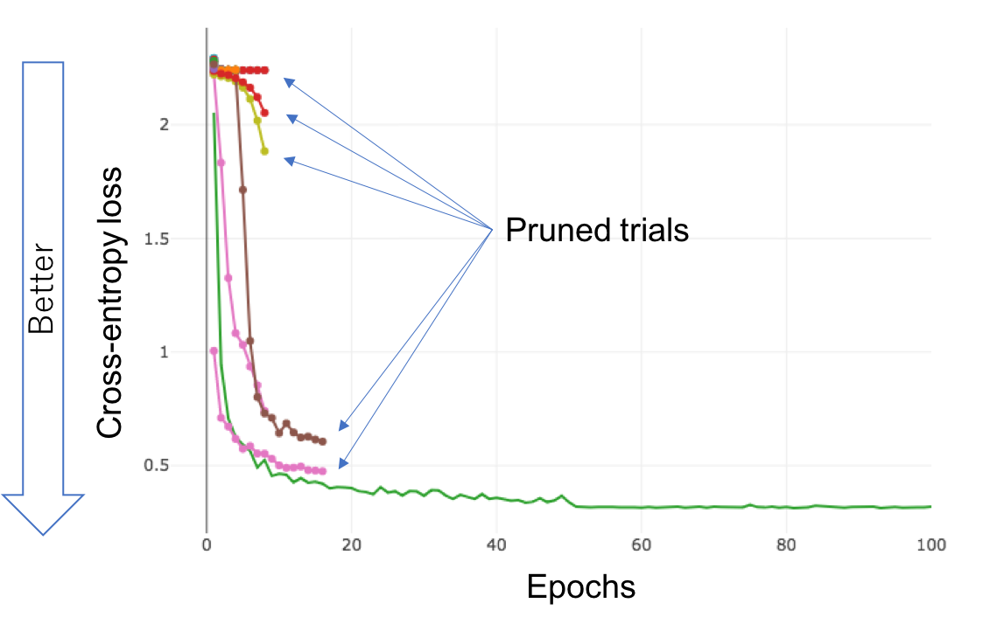
Pruning
Pruning is Optuna’s method of early stopping trials that are unlikely to have good results
The Pruning Strategy constantly checks for performance during training and terminates trials with poor performance
Pruning drastically reduces computation time of a study

Slide 10
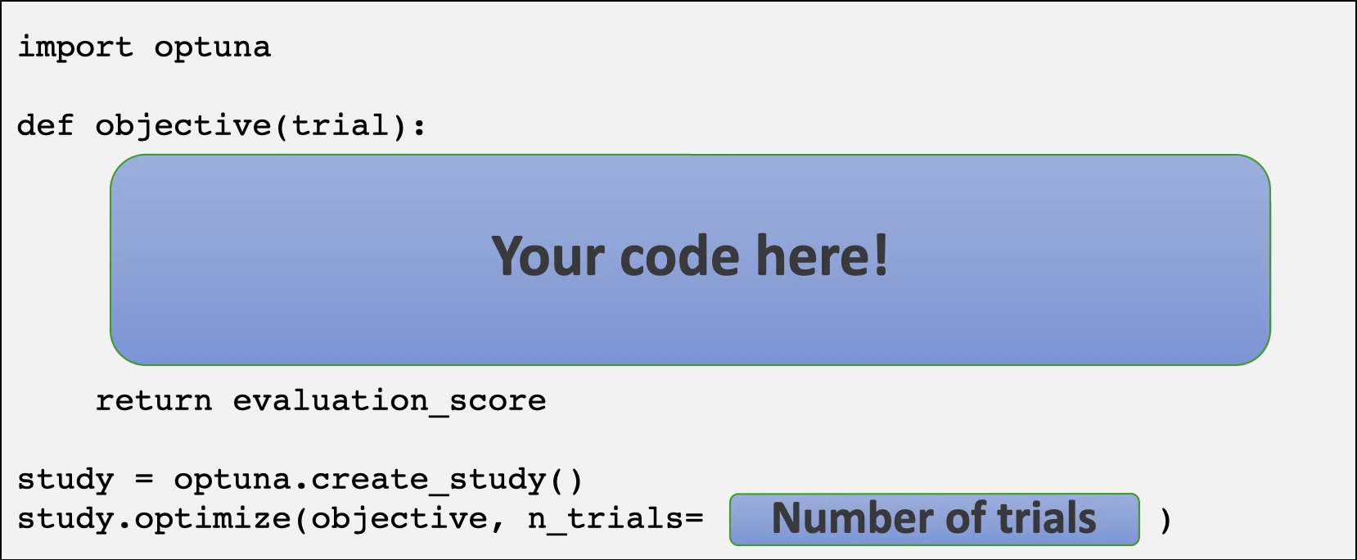
Objective Function
The Objective Function is where we specify what metric we want to optimize

Slide 11
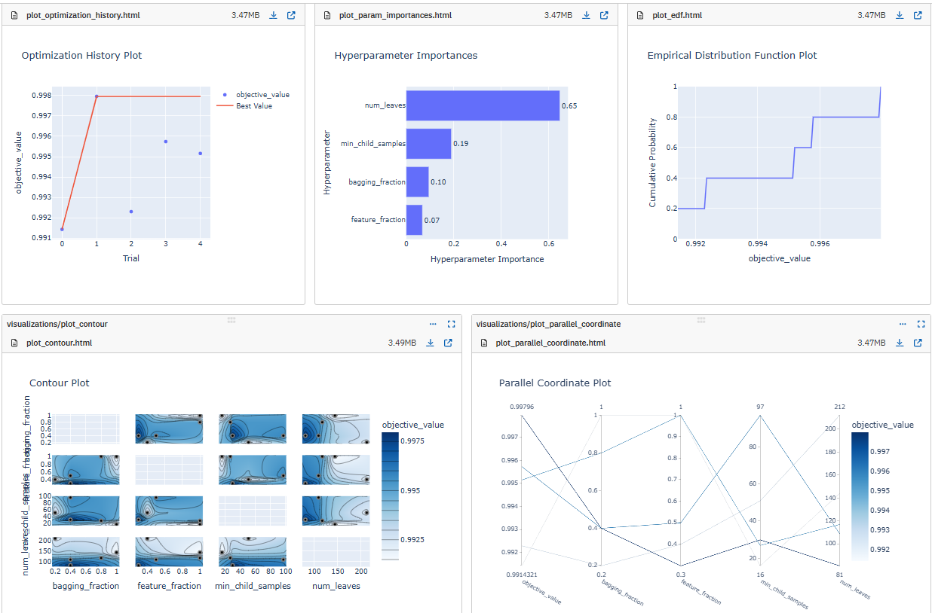
Visual Analysis

Slide 12
Workflow
Define the Objective Function
Specify what you’re trying to optimize
Define your model, dataset, and evaluation logic
Create a study
Controls the optimization process
Chooses a sampler and optionally a pruner
Run the Optimization Loop
Optuna runs multiple trials to explore the search space
Monitor and Prune (Optional but recommended)
Report intermediate metrics during training
Optuna can stop bad runs early, saving time and resources
Visualize and Analyze Results
using build in tools to plot optimization_history()
View hyperparameter importance, contour plots, and convergence trends
Use Best Parameters
Access the best trial with study.best_trial.params
Use parameters in your final model

Slide 13
03
Coding Lab!!!
Let’s practice using Optuna and see some of its features
**insert link

Slide 14
04
Best Practices/Tips
Some best practices when using Optuna

Slide 15
Practical Tips & Best Practices
Define a Sensible Search Space
Don’t go too wide – unrealistic ranges waste time
Visualize Often
Check optimization history early to catch plateaus or regressions
Use importance plots to focus on relevant hyper parameters
Integrate Into Your Pipeline
Treat optuna like part of your ML pipeline
Combine with MLFlow, Weights & Biases to make experiments reproducible and production-ready

Slide 16
Thank you!
Any Questions?

